Slide 1
Using SQL Developer

Slide 2
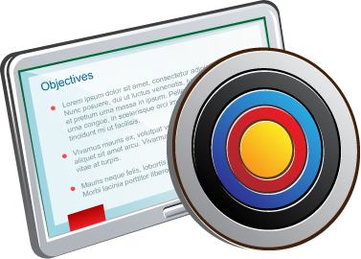
Objectives
After completing this appendix, you should be able to:
List the key features of Oracle SQL Developer
Identify the menu items of Oracle SQL Developer
Create a database connection
Manage database objects
Use SQL Worksheet
Save and run SQL scripts
Create and save reports
Browse the Data Modeling options in SQL Developer
Notes:
In this appendix, you are introduced to the graphical tool called SQL Developer. You learn how to use SQL Developer for your database development tasks. You learn how to use SQL Worksheet to execute SQL statements and SQL scripts.

Slide 3

What Is Oracle SQL Developer?
Oracle SQL Developer is a graphical tool that enhances productivity and simplifies database development tasks.
You can connect to any target Oracle database schema by using standard Oracle database authentication.
SQL Developer
Notes:
Oracle SQL Developer is a free graphical tool designed to improve your productivity and simplify the development of everyday database tasks. With just a few clicks, you can easily create and debug stored procedures, test SQL statements, and view optimizer plans.
SQL Developer, which is the visual tool for database development, simplifies the following tasks:
Browsing and managing database objects
Executing SQL statements and scripts
Editing and debugging PL/SQL statements
Creating reports
You can connect to any target Oracle database schema by using standard Oracle database authentication. When connected, you can perform operations on objects in the database.
SQL Developer is the interface to administer the Oracle Application Express Listener. The new interface enables you to specify global settings and multiple database settings with different database connections for the Application Express Listener. SQL Developer provides the option to drag and drop objects by table or column name onto the worksheet. It provides improved DB Diff comparison options, GRANT statement support in the SQL editor, and DB Doc reporting. Additionally, SQL Developer includes support for Oracle Database 12c features.

Slide 4

Specifications of SQL Developer
Is shipped along with Oracle Database 12c Release 1
Is developed in Java
Supports Windows, Linux, and Mac OS X platforms
Enables default connectivity using the JDBC Thin driver
Connects to Oracle Database version 9.2.0.1 and later
Notes:
Oracle SQL Developer is shipped along with Oracle Database 12c Release 1 by default. SQL Developer is developed in Java, leveraging the Oracle JDeveloper integrated development environment (IDE). Therefore, it is a cross-platform tool. The tool runs on Windows, Linux, and Mac operating system (OS) X platforms.
The default connectivity to the database is through the Java Database Connectivity (JDBC) Thin driver, and therefore, no Oracle Home is required. SQL Developer does not require an installer and you need to simply unzip the downloaded file. With SQL Developer, users can connect to Oracle Databases 9.2.0.1 and later, and all Oracle database editions, including Express Edition.
Note: For Oracle Database 12c Release 1, you will have to download and install SQL Developer. SQL Developer is freely downloadable from the following link: http://www.oracle.com/technetwork/developer-tools/sql-developer/downloads/index.html
For instructions on how to install SQL Developer, see the website at: http://www.oracle.com/technetwork/developer-tools/sql-developer/overview/index.html

Slide 5
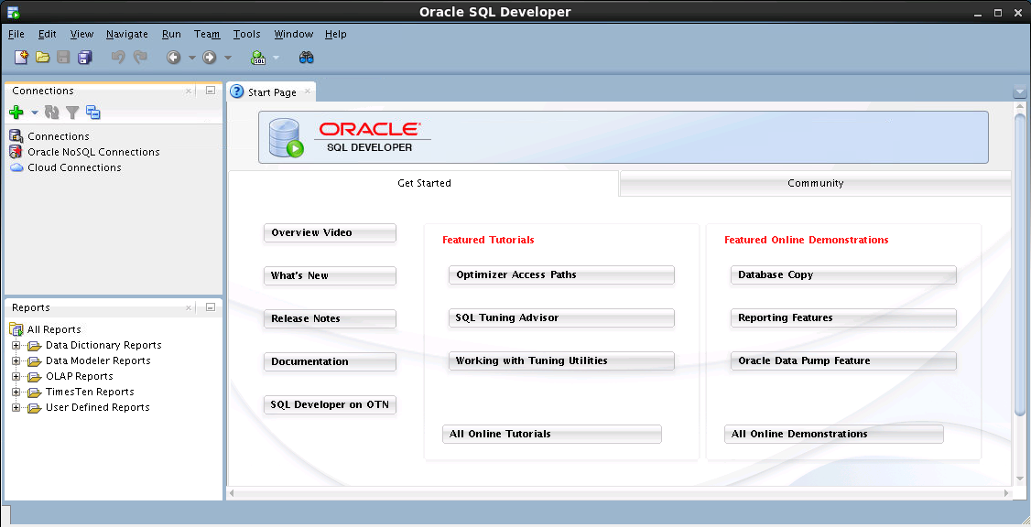
SQL Developer 3.2 Interface
You must define a connection to start using SQL Developer for running SQL queries on a database schema.
Notes:
The SQL Developer interface contains two main navigation tabs:
Connections: By using this tab, you can browse database objects and users to which you have access.
Reports: Identified by the Reports icon, this tab enables you to run predefined reports or create and add your own reports.
General Navigation and Use
SQL Developer uses the left side for navigation to find and select objects, and the right side to display information about selected objects. You can customize many aspects of the appearance and behavior of SQL Developer by setting preferences.
Note: You need to define at least one connection to be able to connect to a database schema and issue SQL queries or run procedures and functions.

Slide 6
Notes:
Menus
The following menus contain standard entries, plus entries for features that are specific to SQL Developer:
View: Contains options that affect what is displayed in the SQL Developer interface
Navigate: Contains options for navigating to panes and for executing subprograms
Run: Contains the Run File and Execution Profile options that are relevant when a function or procedure is selected, and also debugging options
Versioning: Provides integrated support for the following versioning and source control systems—Concurrent Versions System (CVS) and Subversion
Tools: Invokes SQL Developer tools such as SQL*Plus, Preferences, and SQL Worksheet. It also contains options related to migrating third-party databases to Oracle.
Note: The Run menu also contains options that are relevant when a function or procedure is selected for debugging.

Slide 7

Creating a Database Connection
You must have at least one database connection to use SQL Developer.
You can create and test connections for:
Multiple databases
Multiple schemas
SQL Developer automatically imports any connections defined in the tnsnames.ora file on your system.
You can export connections to an Extensible Markup Language (XML) file.
Each additional database connection created is listed in the Connections Navigator hierarchy.
Notes:
A connection is a SQL Developer object that specifies the necessary information for connecting to a specific database as a specific user of that database. To use SQL Developer, you must have at least one database connection, which may be existing, created, or imported.
You can create and test connections for multiple databases and for multiple schemas.
By default, the tnsnames.ora file is located in the $ORACLE_HOME/network/admin directory, but it can also be in the directory specified by the TNS_ADMIN environment variable or registry value. When you start SQL Developer and open the Database Connections dialog box, SQL Developer automatically imports any connections defined in the tnsnames.ora file on your system.
Note: On Windows, if the tnsnames.ora file exists, but its connections are not being used by SQL Developer, define TNS_ADMIN as a system environment variable.
You can export connections to an XML file so that you can reuse it.
You can create additional connections as different users to the same database or to connect to the different databases.

Slide 8
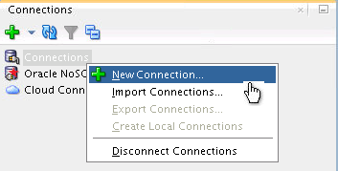
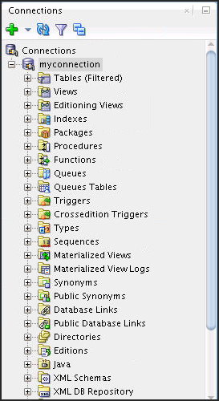
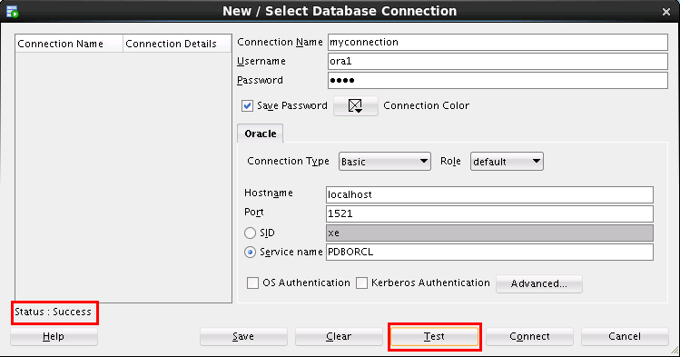
Creating a Database Connection
1
3
2
Notes:
To create a database connection, perform the following steps:
1. On the Connections tabbed page, right-click Connections and select New Connection.
2. In the New / Select Database Connection window, enter the connection name. Enter the username and password of the schema that you want to connect to.
a. From the Role drop-down list, you can select either default or SYSDBA. (You choose SYSDBA for the sys user or any user with database administrator privileges.)
b. You can select the connection type as:
Basic: In this type, enter host name and SID for the database that you want to connect to. Port is already set to 1521. You can also choose to enter the Service name directly if you use a remote database connection.
TNS: You can select any one of the database aliases imported from the tnsnames.ora file.
LDAP: You can look up database services in Oracle Internet Directory, which is a component of Oracle Identity Management.
Advanced: You can define a custom Java Database Connectivity (JDBC) URL to connect to the database.
Local/Bequeath: If the client and database exist on the same computer, a client connection can be passed directly to a dedicated server process without going through the listener.

Slide 9
Notes:
c. Click Test to ensure that the connection has been set correctly.
d. Click Connect.
If you select the Save Password check box, the password is saved to an XML file. So, after you close the SQL Developer connection and open it again, you are not prompted for the password.
3. The connection gets added in the Connections Navigator. You can expand the connection to view the database objects and view object definitions (dependencies, details, statistics, and so on).
Note: From the same New/Select Database Connection window, you can define connections to non-Oracle data sources using the Access, MySQL, and SQL Server tabs. However, these connections are read-only connections that enable you to browse objects and data in that data source.

Slide 10
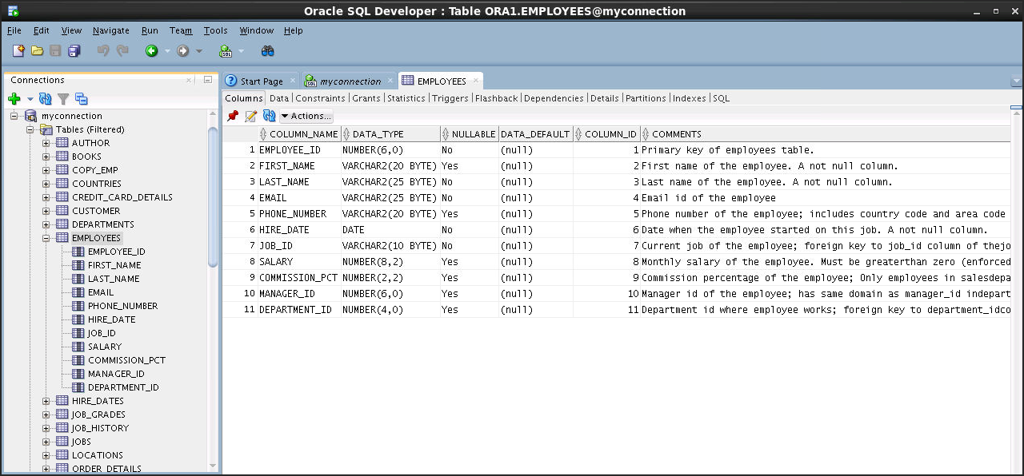
Browsing Database Objects
Use the Connections Navigator to:
Browse through many objects in a database schema
Review the definitions of objects at a glance
Notes:
After you create a database connection, you can use the Connections Navigator to browse through many objects in a database schema, including Tables, Views, Indexes, Packages, Procedures, Triggers, and Types.
SQL Developer uses the left side for navigation to find and select objects, and the right side to display information about the selected objects. You can customize many aspects of the appearance of SQL Developer by setting preferences.
You can see the definition of the objects broken into tabs of information that is pulled out of the data dictionary. For example, if you select a table in the Navigator, details about columns, constraints, grants, statistics, triggers, and so on are displayed on an easy-to-read tabbed page.
If you want to see the definition of the EMPLOYEES table as shown in the slide, perform the following steps:
1. Expand the Connections node in the Connections Navigator.
2. Expand Tables.
Click EMPLOYEES. By default, the Columns tab is selected. It shows the column description of the table. Using the Data tab, you can view the table data and also enter new rows, update data, and commit these changes to the database.

Slide 11

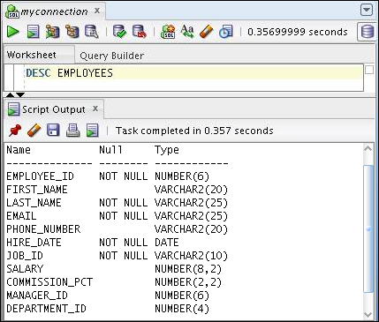
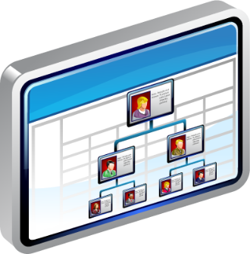
Displaying the Table Structure
Use the DESCRIBE command to display the structure of a table:
Notes:
In SQL Developer, you can also display the structure of a table using the DESCRIBE command. The result of the command is a display of column names and data types, as well as an indication of whether a column must contain data.

Slide 12
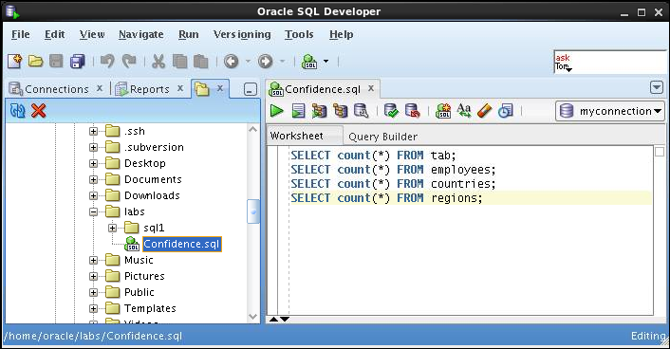

Browsing Files
Use the File Navigator to explore the file system and open system files.
Notes:
Browsing Database Objects
You can use the File Navigator to browse and open system files.
To view the File Navigator, click the View tab and select Files, or select View > Files.
To view the contents of a file, double-click a file name to display its contents in the SQL Worksheet area.

Slide 13
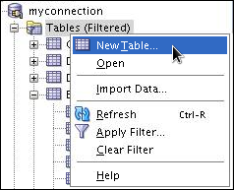

Creating a Schema Object
SQL Developer supports the creation of any schema object by:
Executing a SQL statement in SQL Worksheet
Using the context menu
Edit the objects by using an edit dialog box or one of the many context-sensitive menus.
View the data definition language (DDL) for adjustments such as creating a new object or editing an existing schema object.
Notes:
SQL Developer supports the creation of any schema object by executing a SQL statement in SQL Worksheet. Alternatively, you can create objects by using the context menus. When created, you can edit objects using an edit dialog box or one of the many context-sensitive menus.
As new objects are created or existing objects are edited, the DDL for those adjustments is available for review. An Export DDL option is available if you want to create the full DDL for one or more objects in the schema.
The slide shows how to create a table using the context menu. To open a dialog box for creating a new table, right-click Tables and select New Table. The dialog boxes to create and edit database objects have multiple tabs, each reflecting a logical grouping of properties for that type of object.

Slide 14
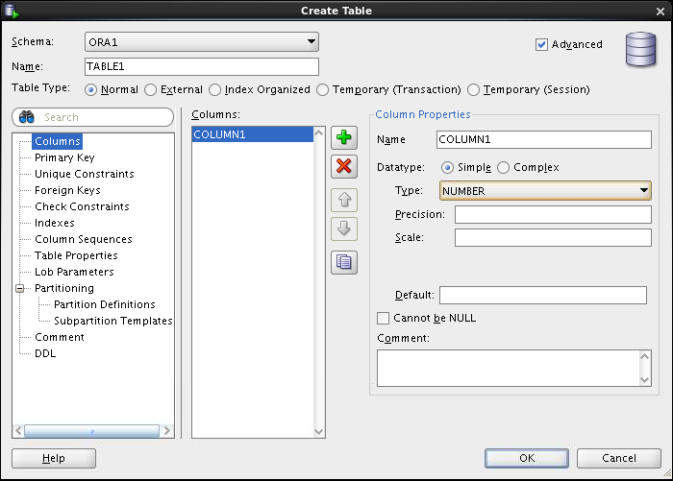

Creating a New Table: Example
Notes:
In the Create Table dialog box, if you do not select the Advanced check box, you can create a table quickly by specifying columns and some frequently used features.
If you select the Advanced check box, the Create Table dialog box changes to one with multiple options, in which you can specify an extended set of features while you create the table.
The example in the slide shows how to create the DEPENDENTS table by selecting the Advanced check box.
To create a new table, perform the following steps:
1. In the Connections Navigator, right-click Tables and select Create TABLE.
2. In the Create Table dialog box, select Advanced.
3. Specify the column information.
4. Click OK.
Although it is not required, you should also specify a primary key by using the Primary Key tab in the dialog box. Sometimes, you may want to edit the table that you have created; to do so, right-click the table in the Connections Navigator and select Edit.

Slide 15
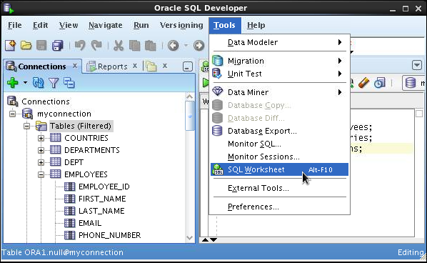
Using the SQL Worksheet
Use the SQL Worksheet to enter and execute SQL, PL/SQL, and SQL*Plus statements.
Specify any actions that can be processed by the database connection associated with the worksheet.
Or, click the Open SQL Worksheet icon.
Select SQL Worksheet from the Tools menu.
Notes:
When you connect to a database, a SQL Worksheet window for that connection automatically opens. You can use the SQL Worksheet to enter and execute SQL, PL/SQL, and SQL*Plus statements. The SQL Worksheet supports SQL*Plus statements to a certain extent. SQL*Plus statements that are not supported by the SQL Worksheet are ignored and not passed to the database.
You can specify the actions that can be processed by the database connection associated with the worksheet, such as:
Creating a table
Inserting data
Creating and editing a trigger
Selecting data from a table
Saving the selected data to a file
You can display a SQL Worksheet by using one of the following:
Select Tools > SQL Worksheet.
Click the Open SQL Worksheet icon.

Slide 16
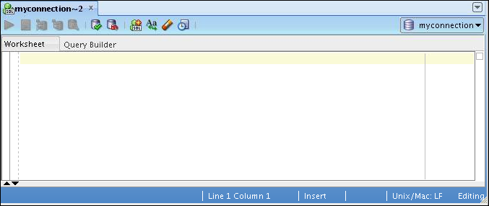
Using the SQL Worksheet
2
4
6
8
10
1
3
5
7
9
11
Notes:
You may want to use the shortcut keys or icons to perform certain tasks such as executing a SQL statement, running a script, and viewing the history of the SQL statements that you have executed. You can use the SQL Worksheet toolbar that contains icons to perform the following tasks:
1. Run Statement: Executes the statement where the cursor is located in the Enter SQL Statement box. You can use bind variables in the SQL statements, but not substitution variables.
2. Run Script: Executes all the statements in the Enter SQL Statement box by using the Script Runner. You can use substitution variables in the SQL statements, but not bind variables.
3. Autotrace: Generates trace information for the statement
4. Explain Plan: Generates the execution plan, which you can see by clicking the Explain tab
5. SQL Tuning Advisory: Analyzes high-volume SQL statements and offers tuning recommendations
6. Commit: Writes any changes to the database and ends the transaction
7. Rollback: Discards any changes to the database, without writing them to the database, and ends the transaction

Slide 17
Notes:
8. Unshared SQL Worksheet: Creates a separate unshared SQL Worksheet for a connection
9. To Upper/Lower/InitCap: Changes the selected text to uppercase, lowercase, or initcap, respectively
10. Clear: Erases the statement or statements in the Enter SQL Statement box
11. SQL History: Displays a dialog box with information about the SQL statements that you have executed

Slide 18
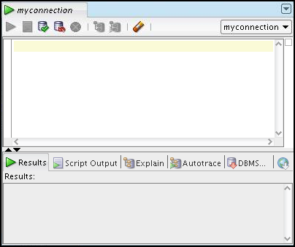
Using the SQL Worksheet
Use the SQL Worksheet to enter and execute SQL, PL/SQL, and SQL*Plus statements.
Specify any actions that can be processed by the database connection associated with the worksheet.
Enter SQL statements.
Results are shown here.
Notes:
When you connect to a database, a SQL Worksheet window for that connection automatically opens. You can use the SQL Worksheet to enter and execute SQL, PL/SQL, and SQL*Plus statements. All SQL and PL/SQL commands are supported as they are passed directly from the SQL Worksheet to the Oracle database. The SQL*Plus commands that are used in SQL Developer must be interpreted by the SQL Worksheet before being passed to the database.
The SQL Worksheet currently supports a number of SQL*Plus commands. Commands that are not supported by the SQL Worksheet are ignored and not sent to the Oracle database. Through the SQL Worksheet, you can execute the SQL statements and some of the SQL*Plus commands.

Slide 19
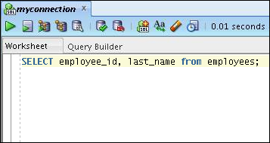
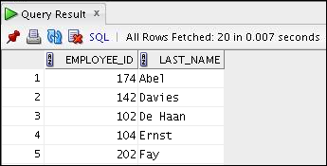
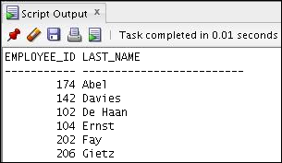
Executing SQL Statements
Use the Enter SQL Statement box to enter single or multiple SQL statements.
F9
F5
F5
F9
Notes:
The example in the slide shows the difference in output for the same query when the F9 key or Execute Statement is used versus the output when F5 or Run Script is used.

Slide 20

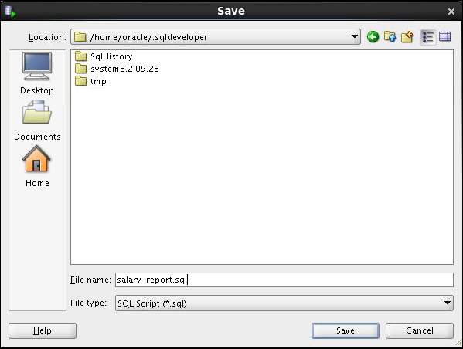
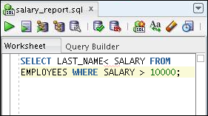
Saving SQL Scripts
Click the Save icon to save your SQL statement to a file.
1
3
The contents of the saved file are visible and editable in your SQL Worksheet window.
Identify a location, enter a file name, and click Save.
2
Notes:
You can save your SQL statements from the SQL Worksheet to a text file. To save the contents of the Enter SQL Statement box, perform the following steps:
1. Click the Save icon or use the File > Save menu item.
2. In the Save dialog box, enter a file name and the location where you want the file saved.
3. Click Save.
After you save the contents to a file, the Enter SQL Statement window displays a tabbed page of your file contents. You can have multiple files open at the same time. Each file is displayed as a tabbed page.
Script Pathing
You can select a default path to look for scripts and to save scripts. Under Tools > Preferences > Database > Worksheet Parameters, enter a value in the “Select default path to look for scripts” field.

Slide 21
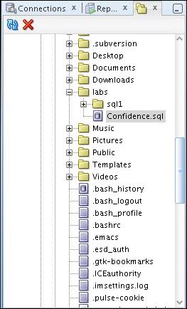
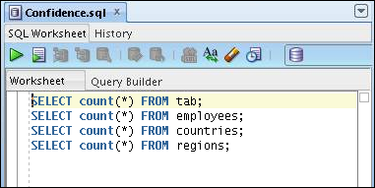
Executing Saved Script Files: Method 1
Use the Files tab to locate the script file that you want to open.
Double-click the script to display the code in the SQL Worksheet.
1
To run the code, click either:
Execute Script (F9), or
Run Script (F5)
Select a connection from the drop-down list.
3
2
Notes:
To open a script file and display the code in the SQL Worksheet area, perform the following steps:
1. In the files navigator, select (or navigate to) the script file that you want to open.
2. Double-click the file to open it. The code of the script file is displayed in the SQL Worksheet area.
3. Select a connection from the connection drop-down list.
4. To run the code, click the Run Script (F5) icon on the SQL Worksheet toolbar. If you have not selected a connection from the connection drop-down list, a connection dialog box will appear. Select the connection that you want to use for the script execution.
Alternatively, you can also do the following:
1. Select File > Open. The Open dialog box is displayed.
2. In the Open dialog box, select (or navigate to) the script file that you want to open.
3. Click Open. The code of the script file is displayed in the SQL Worksheet area.
4. Select a connection from the connection drop-down list.
5. To run the code, click the Run Script (F5) icon on the SQL Worksheet toolbar. If you have not selected a connection from the connection drop-down list, a connection dialog box will appear. Select the connection that you want to use for the script execution.

Slide 22
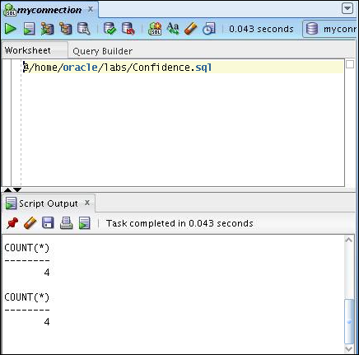
Executing Saved Script Files: Method 2
Use the @ command followed by the location and name of the file that you want to execute and click the Run Script icon.
The output from the script is displayed on the Script Output tabbed page.
Notes:
To run a saved SQL script, perform the following steps:
1. Use the @ command followed by the location and the name of the file that you want to run in the Enter SQL Statement window.
Click the Run Script icon.
The results from running the file are displayed on the Script Output tabbed page. You can also save the script output by clicking the Save icon on the Script Output tabbed page. The File Save dialog box appears and you can identify a name and location for your file.

Slide 23
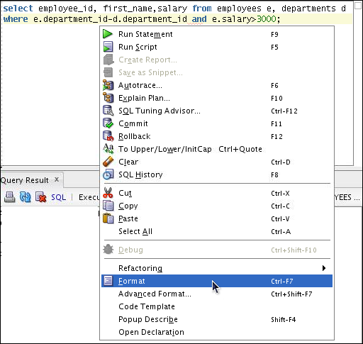
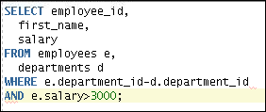
Formatting the SQL Code
__________________________________
____________________
_____
.SQL
Before
formatting
After
formatting
Notes:
You may want to format the indentation, spacing, capitalization, and line separation of the SQL code. SQL Developer has a feature for formatting SQL code.
To format the SQL code, right-click in the statement area and select Format.
In the example in the slide, before formatting, the SQL code has the keywords not capitalized and the statement not properly indented. After formatting, the SQL code is beautified with the keywords capitalized and the statement properly indented.

Slide 24
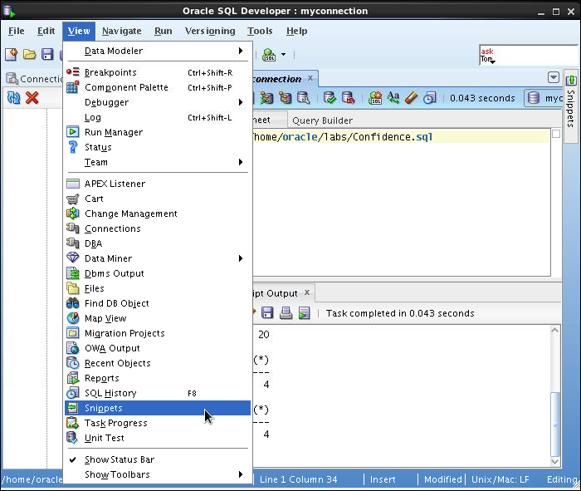
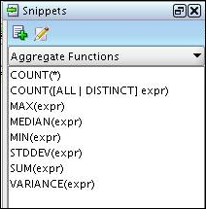
Using Snippets
Snippets are code fragments that may be just syntax or examples.
When you place your cursor here, it shows the Snippets window. From the drop-down list, you can select the functions category that you want.
Notes:
You may want to use certain code fragments when you use the SQL Worksheet or create or edit a PL/SQL function or procedure. SQL Developer has a feature called Snippets. Snippets are code fragments such as SQL functions, optimizer hints, and miscellaneous PL/SQL programming techniques. You can drag snippets to the Editor window.
To display Snippets, select View > Snippets.
The Snippets window is displayed on the right. You can use the drop-down list to select a group. A Snippets button is placed in the right window margin, so that you can display the Snippets window if it becomes hidden.

Slide 25
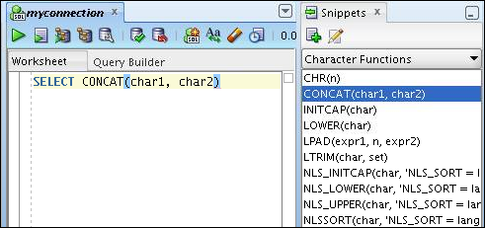
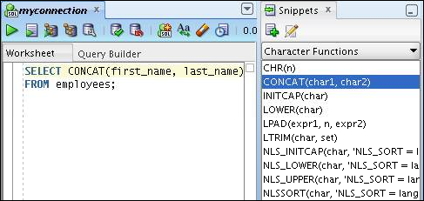
Using Snippets: Example
Inserting a
snippet
Editing the
snippet
Notes:
To insert a Snippet into your code in a SQL Worksheet or in a PL/SQL function or procedure, drag the snippet from the Snippets window to the desired place in your code. Then you can edit the syntax so that the SQL function is valid in the current context. To see a brief description of a SQL function in a tool tip, place the cursor over the function name.
The example in the slide shows that CONCAT(char1, char2)is dragged from the Character Functions group in the Snippets window. Then the CONCAT function syntax is edited and the rest of the statement is added as in the following:
SELECT CONCAT(first_name, last_name)
FROM employees;

Slide 26
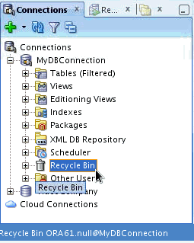
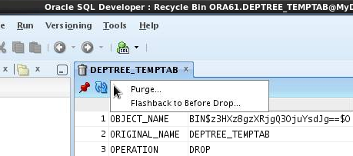
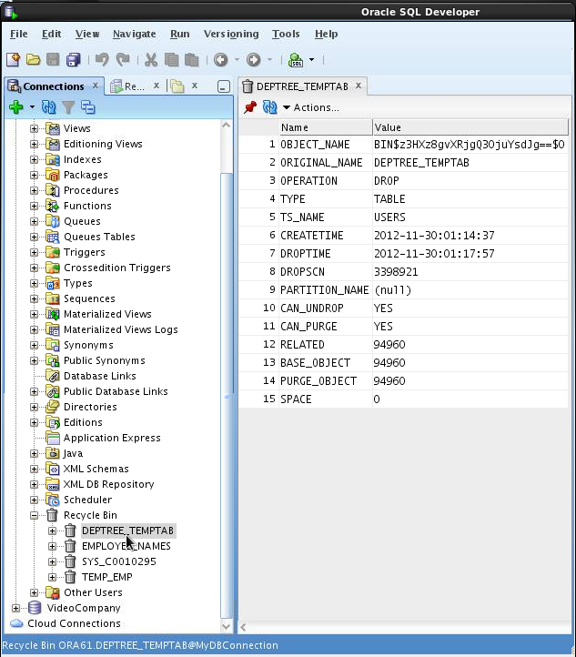
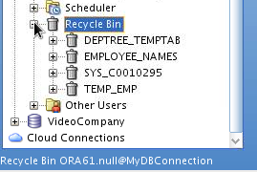
Using the Recycle Bin
The recycle bin holds objects that have been dropped.
4
Select the operations from the drop-down Actions list.
1
3
Purge: Removes the object from the Recycle bin and deletes it
Flashback to Before Drop: Moves the object from the recycle bin back to its appropriate place in the Connections navigator display
2
Notes:
The recycle bin is a data dictionary table containing information about dropped objects. Dropped tables and any associated objects such as indexes, constraints, nested tables, and the likes are not removed and still occupy space. They continue to count against user space quotas, until specifically purged from the recycle bin or the unlikely situation where they must be purged by the database because of tablespace space constraints.
To use the recycle bin, perform the following steps:
1. In the Connections navigator, select (or navigate to) the recycle bin.
2. Expand Recycle Bin and click the object name. The object details are displayed in the SQL Worksheet area.
3. Click the Actions drop-down list and select the operation that you want to perform on the object.

Slide 27
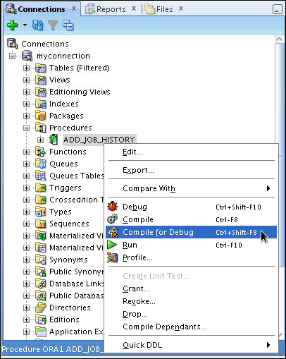
Debugging Procedures and Functions
Use SQL Developer to debug PL/SQL functions and procedures.
Use the Compile for Debug option to perform a PL/SQL compilation so that the procedure can be debugged.
Use the Debug menu options to set breakpoints, and to perform Step Into and Step Over tasks.
Notes:
In SQL Developer, you can debug PL/SQL procedures and functions. Using the Debug menu options, you can perform the following debugging tasks:
Find Execution Point goes to the next execution point.
Resume continues execution.
Step Over bypasses the next method and goes to the next statement after the method.
Step Into goes to the first statement in the next method.
Step Out leaves the current method and goes to the next statement.
Step to End of Method goes to the last statement of the current method.
Pause halts execution, but does not exit, thus allowing you to resume execution.
Terminate halts and exits the execution. You cannot resume execution from this point; instead, to start running or debugging from the beginning of the function or procedure, click the Run or Debug icon on the Source tab toolbar.
Garbage Collection removes invalid objects from the cache in favor of more frequently accessed and more valid objects.
These options are also available as icons on the Debugging tab of the output window.

Slide 28
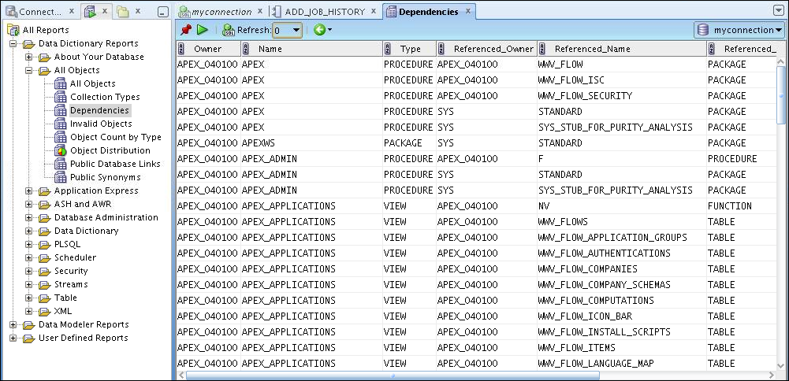
Database Reporting
SQL Developer provides a number of predefined reports about the database and its objects.
Notes:
SQL Developer provides many reports about the database and its objects. These reports can be grouped into the following categories:
About Your Database reports
Database Administration reports
Table reports
PL/SQL reports
Security reports
XML reports
Jobs reports
Streams reports
All Objects reports
Data Dictionary reports
User-Defined reports
To display reports, click the Reports tab on the left of the window. Individual reports are displayed in tabbed panes on the right of the window; for each report, you can select (using a drop-down list) the database connection for which to display the report. For reports about objects, the objects shown are only those visible to the database user associated with the selected database connection, and the rows are usually ordered by Owner. You can also create your own user-defined reports.

Slide 29
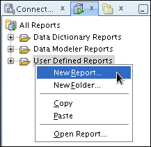
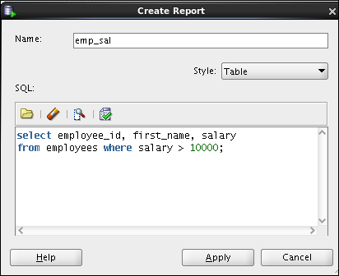
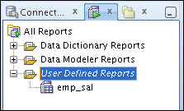
Creating a User-Defined Report
Create and save user-defined reports for repeated use.
Organize reports in folders.
Notes:
User-defined reports are reports created by SQL Developer users. To create a user-defined report, perform the following steps:
1. Right-click the User Defined Reports node under Reports and select Add Report.
2. In the Create Report dialog box, specify the report name and the SQL query to retrieve information for the report. Then click Apply.
In the example in the slide, the report name is specified as emp_sal. An optional description is provided indicating that the report contains details of employees with salary >= 10000. The complete SQL statement for retrieving the information to be displayed in the user-defined report is specified in the SQL box. You can also include an optional tool tip to be displayed when the cursor stays briefly over the report name in the Reports navigator display.
You can organize user-defined reports in folders and you can create a hierarchy of folders and subfolders. To create a folder for user-defined reports, right-click the User Defined Reports node or any folder name under that node and select Add Folder. Information about user-defined reports, including any folders for these reports, is stored in a file named UserReports.xml in the directory for user-specific information.

Slide 30
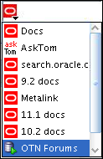
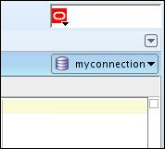
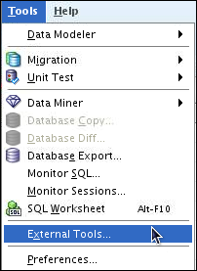
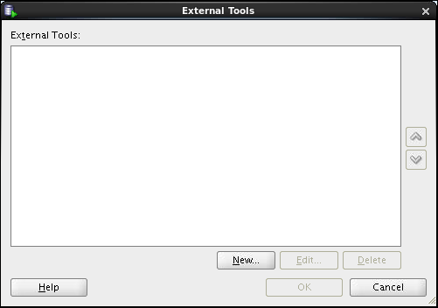
Search Engines and External Tools
1
Links to popular search engines and discussion forums
Shortcut to switch between connections
2
Notes:
To enhance the productivity of developers, SQL Developer has added quick links to popular search engines and discussion forums such as AskTom, Google, and so on. Also, you have shortcut icons to some of the frequently used tools such as Notepad, Microsoft Word, and Dreamweaver, available to you.
You can add external tools to the existing list or even delete shortcuts to the tools that you do not use frequently. To do so, perform the following steps:
1. From the Tools menu, select External Tools.
2. In the External Tools dialog box, select New to add new tools. Select Delete to remove any tool from the list.

Slide 31


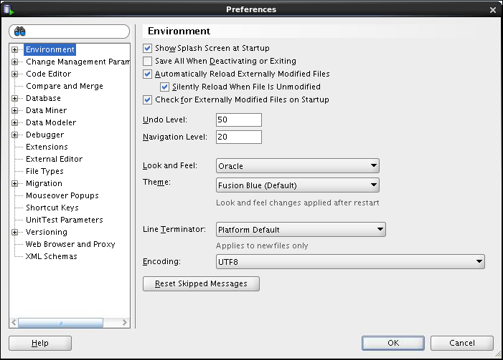
Setting Preferences
Customize the SQL Developer interface and environment.
In the Tools menu, select Preferences.
Notes:
You can customize many aspects of the SQL Developer interface and environment by modifying SQL Developer preferences according to your needs. To modify SQL Developer preferences, select Tools, and then Preferences.
The preferences are grouped into the following categories:
Environment
Change Management Parameter
Code Editors
Compare and Merge
Database
Data Miner
Data Modeler
Debugger
Extensions
External Editor
File Types

Slide 32
Notes:
Migration
Mouseover Popups
Shortcut Keys
Unit Test Parameters
Versioning
Web Browser and Proxy
XML Schemas

Slide 33
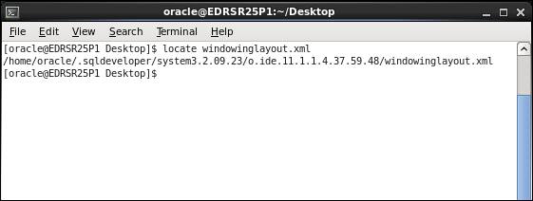

Resetting the SQL Developer Layout
Notes:
While working with SQL Developer, if the Connections Navigator disappears or if you cannot dock the Log window in its original place, perform the following steps to fix the problem:
1. Exit SQL Developer.
2. Open a terminal window and use the locate command to find the location of windowinglayout.xml.
3. Go to the directory that has windowinglayout.xml and delete it.
4. Restart SQL Developer.

Slide 34
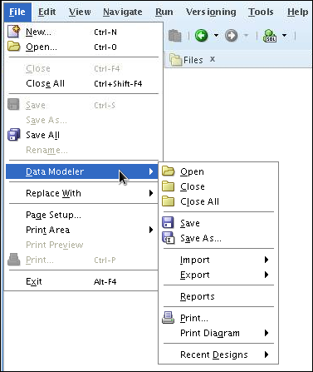
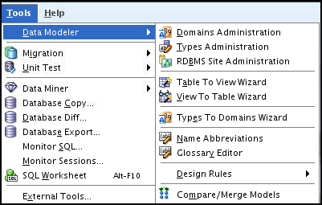
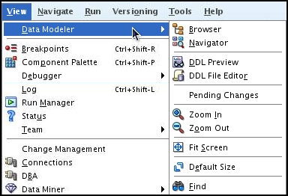
Data Modeler in SQL Developer
SQL Developer includes an integrated version of SQL Developer Data Modeler.
The Tools > Data Modeler menu options provide the administration and wizard options.
The File > Data Modeler menu options allow you to open, save, and print design models.
The View > Data Modeler menu options provide navigation and view options.
Notes:
Using the integrated version of the SQL Developer Data Modeler, you can:
Create, open, import, and save a database design
Create, modify, and delete Data Modeler objects
To display Data Modeler in a pane, click Tools, and then Data Modeler. The Data Modeler menu under Tools includes additional commands, for example, that enable you to specify design rules and preferences.

Slide 35
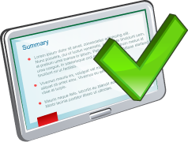
Summary
In this appendix, you should have learned how to use SQL Developer to do:
Browse, create, and edit database objects
Execute SQL statements and scripts in SQL Worksheet
Create and save custom reports
Browse the Data Modeling options in SQL Developer
Notes:
SQL Developer is a free graphical tool to simplify database development tasks. Using SQL Developer, you can browse, create, and edit database objects. You can use SQL Worksheet to run SQL statements and scripts. SQL Developer enables you to create and save your own special set of reports for repeated use.

